Slide 1


Slide 2
Lecture By Arjun Pukale

Slide 3

Mathematics behind Gradient Descent Learning Algorithm
Part-2
Linear Regression Single Variable

Slide 4
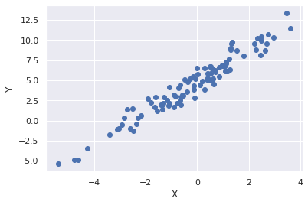
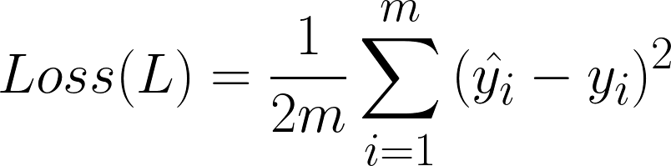
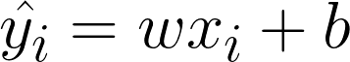
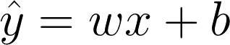
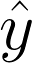
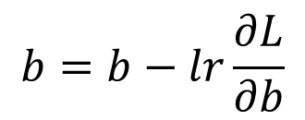
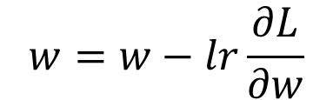
Gradient descent update rule:
X | Y
-1.5 | -2 | -1.7
-1.25 | -1 | -0.9
-1 | 0 | -0.3
-0.75 | -1.5 | -1.2
-0.2 | -0.5 | -0.3
0 | 0.7 | 0.4
…… | …… | ……
$$w=w−lr\frac{∂L}{∂w}$$
$$b=b−lr\frac{∂L}{∂b}$$

Slide 5
Gradient descent update rule:
X | Y
-1.5 | -2 | -1.7
-1.25 | -1 | -0.9
-1 | 0 | -0.3
-0.75 | -1.5 | -1.2
-0.2 | -0.5 | -0.3
0 | 0.7 | 0.4
…… | …… | ……
$$w=w−lr\frac{∂L}{∂w}$$
How to calculate the partial derivatives ?
$$b=b−lr\frac{∂L}{∂b}$$

Slide 6
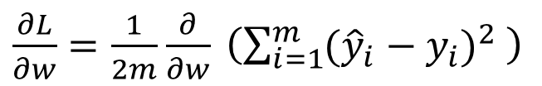
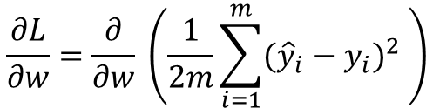
$$\frac{∂L}{∂w}=\frac{∂}{∂w} \left(\frac{1}{2m}\sum_{i=1}^{m}{{({\hat{y}}_{i}−y_{i})}^{2} }\right)$$
$\frac{∂L}{∂w}=\frac{1}{2m}$ $\frac{∂}{∂w} \left(\sum_{i=1}^{m}{{({\hat{y}}_{i}−y_{i})}^{2} }\right)$

Slide 7
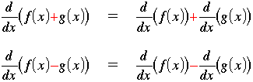
Derivative of sum = sum of derivatives
$$\frac{∂L}{∂w}=\frac{∂}{∂w} \left(\frac{1}{2m}\sum_{i=1}^{m}{{({\hat{y}}_{i}−y_{i})}^{2} }\right)$$
$\frac{∂L}{∂w}=\frac{1}{2m}$ $\frac{∂}{∂w} \left(\sum_{i=1}^{m}{{({\hat{y}}_{i}−y_{i})}^{2} }\right)$
$$\frac{∂L}{∂w}= \frac{1}{2m} \left[\frac{∂}{∂w}{({\hat{y}}_{1}−y_{1})}^{2}+\frac{∂}{∂w}{({\hat{y}}_{2}−y_{2})}^{2}+ ………..\frac{∂}{∂w}{({\hat{y}}_{m}−y_{m})}^{2}\right]$$

Slide 8
Derivative of sum = sum of derivatives
$$\frac{∂L}{∂w}=\frac{∂}{∂w} \left(\frac{1}{2m}\sum_{i=1}^{m}{{({\hat{y}}_{i}−y_{i})}^{2} }\right)$$
$\frac{∂L}{∂w}=\frac{1}{2m}$ $\frac{∂}{∂w} \left(\sum_{i=1}^{m}{{({\hat{y}}_{i}−y_{i})}^{2} }\right)$
$$\frac{∂L}{∂w}= \frac{1}{2m} \left[\frac{∂}{∂w}{({\hat{y}}_{1}−y_{1})}^{2}+\frac{∂}{∂w}{({\hat{y}}_{2}−y_{2})}^{2}+ ……….+\frac{∂}{∂w}{({\hat{y}}_{m}−y_{m})}^{2}\right]$$
How to calculate
Derivative of
a single item

Slide 9
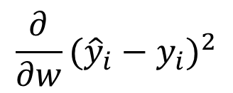
$$\frac{∂}{∂w}{({\hat{y}}_{i}−y_{i})}^{2}$$

Slide 10
$$\frac{∂}{∂w}{({\hat{y}}_{i}−y_{i})}^{2}$$

Slide 11
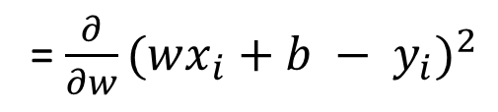
$$\frac{∂}{∂w}{({\hat{y}}_{i}−y_{i})}^{2}$$
= $\frac{∂}{∂w}{(wx_{i}+b − y_{i})}^{2}$

Slide 12
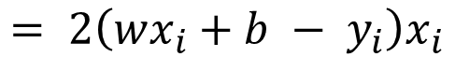
$$\frac{∂}{∂w}{({\hat{y}}_{i}−y_{i})}^{2}$$
= $\frac{∂}{∂w}{(wx_{i}+b − y_{i})}^{2}$
$$= 2\left(wx_{i}+b − y_{i}\right)x_{i}$$

Slide 13
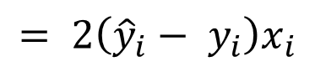
$$\frac{∂}{∂w}{({\hat{y}}_{i}−y_{i})}^{2}$$
= $\frac{∂}{∂w}{(wx_{i}+b − y_{i})}^{2}$
$$= 2\left(wx_{i}+b − y_{i}\right)x_{i}$$
$$= 2\left({\hat{y}}_{i}− y_{i}\right)x_{i}$$

Slide 14
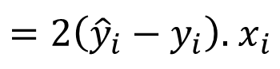
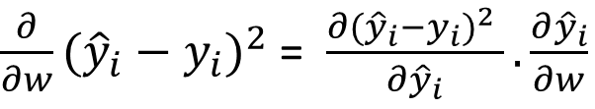
$$\frac{∂}{∂w}{({\hat{y}}_{i}−y_{i})}^{2}$$
Chain Rule
= $\frac{∂}{∂w}{(wx_{i}+b − y_{i})}^{2}$
$\frac{∂}{∂w}{({\hat{y}}_{i}−y_{i})}^{2}$ = $\frac{∂{({\hat{y}}_{i}−y_{i})}^{2} }{∂{\hat{y}}_{i}}.\frac{∂{\hat{y}}_{i}}{∂w}$
$$= 2\left(wx_{i}+b − y_{i}\right)x_{i}$$
$=2\left({\hat{y}}_{i}−y_{i}\right).$ $x_{i}$
$$= 2\left({\hat{y}}_{i}− y_{i}\right)x_{i}$$

Slide 15
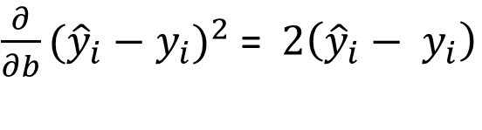
$$\frac{∂}{∂w}{({\hat{y}}_{i}−y_{i})}^{2}$$
Chain Rule
= $\frac{∂}{∂w}{(wx_{i}+b − y_{i})}^{2}$
$\frac{∂}{∂w}{({\hat{y}}_{i}−y_{i})}^{2}$ = $\frac{∂{({\hat{y}}_{i}−y_{i})}^{2} }{∂{\hat{y}}_{i}}.\frac{∂{\hat{y}}_{i}}{∂w}$
$$= 2\left(wx_{i}+b − y_{i}\right)x_{i}$$
$=2\left({\hat{y}}_{i}−y_{i}\right).$ $x_{i}$
$$= 2\left({\hat{y}}_{i}− y_{i}\right)x_{i}$$
Similarly,
$\frac{∂}{∂b}{({\hat{y}}_{i}−y_{i})}^{2}$ =$2\left({\hat{y}}_{i}− y_{i}\right)$

Slide 16
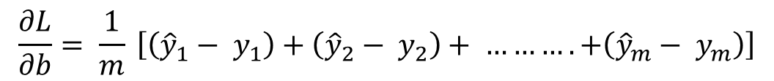
$$\frac{∂L}{∂w}= \frac{1}{2m} \left[\frac{∂}{∂w}{({\hat{y}}_{1}−y_{1})}^{2}+\frac{∂}{∂w}{({\hat{y}}_{2}−y_{2})}^{2}+ ……….+\frac{∂}{∂w}{({\hat{y}}_{m}−y_{m})}^{2}\right]$$
$$\frac{∂L}{∂w}= \frac{1}{2m} \left[2\left({\hat{y}}_{1}− y_{1}\right)x_{1}+2\left({\hat{y}}_{2}− y_{2}\right)x_{2}+ ……….+2\left({\hat{y}}_{m}− y_{m}\right)x_{m}\right]$$
$$\frac{∂L}{∂w}= \frac{1}{m} \left[\left({\hat{y}}_{1}− y_{1}\right)x_{1}+\left({\hat{y}}_{2}− y_{2}\right)x_{2}+ ……….+\left({\hat{y}}_{m}− y_{m}\right)x_{m}\right]$$
Similarly,
$$\frac{∂L}{∂b}= \frac{1}{m} \left[\left({\hat{y}}_{1}− y_{1}\right)+\left({\hat{y}}_{2}− y_{2}\right)+ ……….+\left({\hat{y}}_{m}− y_{m}\right)\right]$$

Slide 17
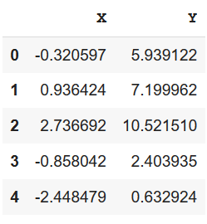
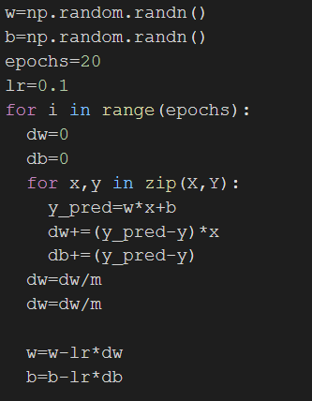
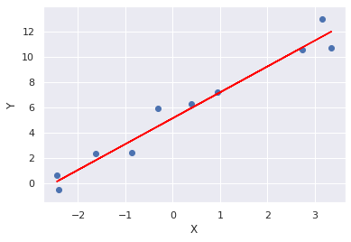
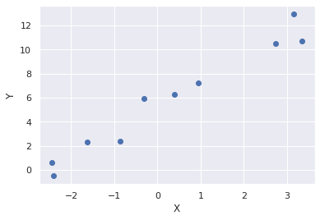
Training Data
Gradient Descent Pseudo Code
One Pass over the Training Data is called an epoch.
The parameters (w,b) are updated once per epoch.
Set appropriate values of no of epochs and learning rate (HyperParameters)
………… ………….

Slide 18
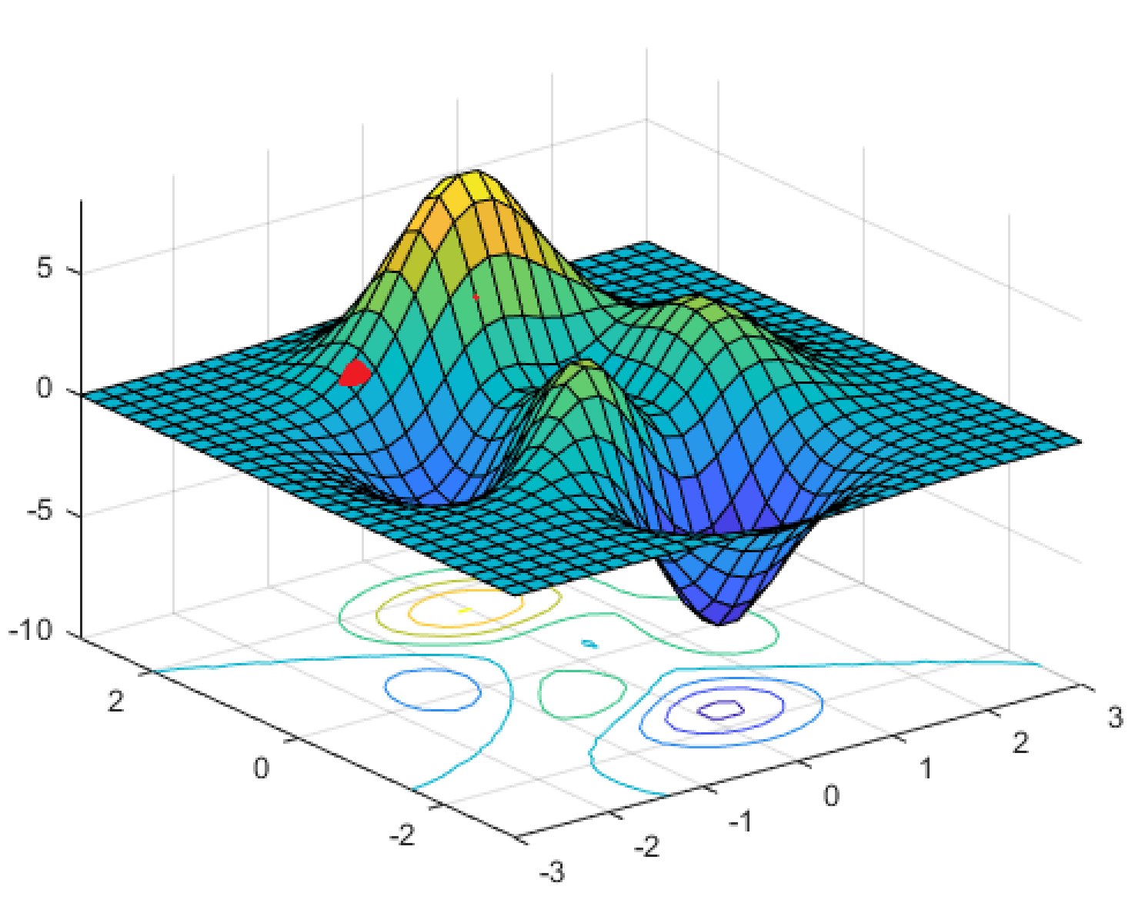
Disadvantages of Gradient Descent:
Only one update per epoch
It is used to reach local minima
It is slow when the slope/gradients are gentle/small

Slide 19
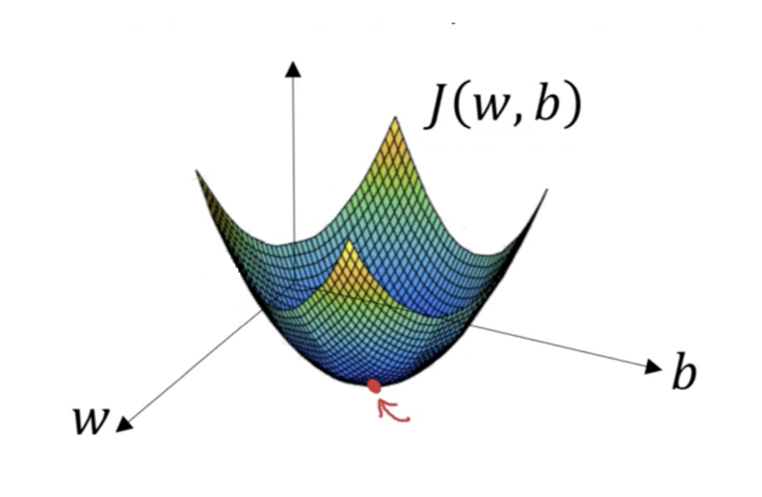
Non Convex
Disadvantages of Gradient Descent:
Only one update per epoch
It is used to reach local minima
It is slow when the slope/gradients are gentle/small
Convex

Slide 20
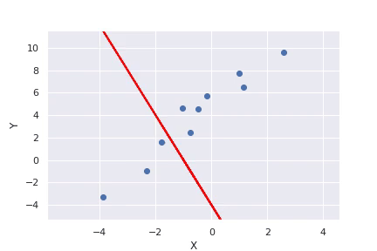
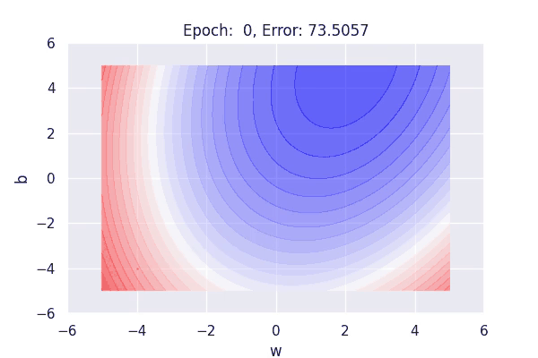
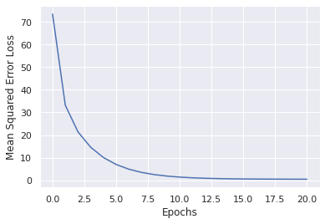
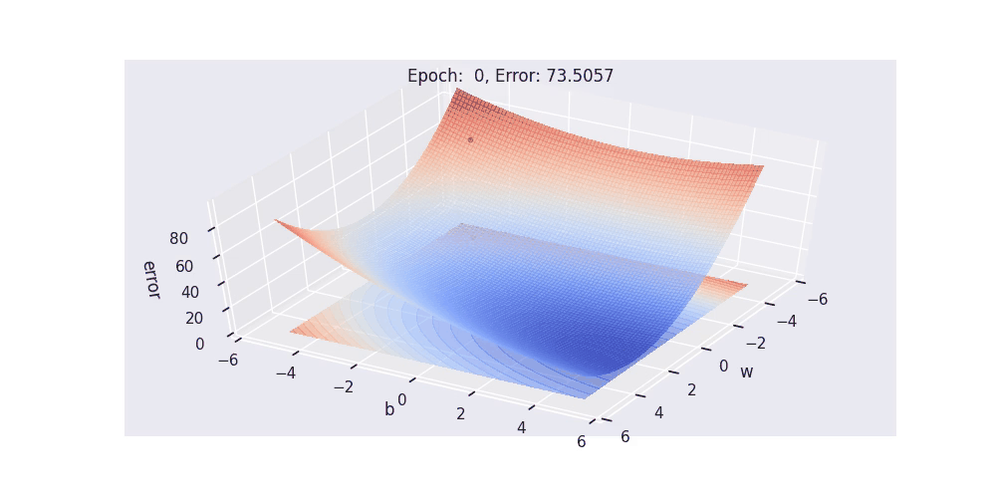
Next: Implement Linear Regression single variable from scratch in python with amazing animations

Slide 21



